Slide 1

Surface Attack Tactics (SAT)
BLUE and RED coordination

Slide 2
Explanation
PRA: PLANNED RELEASE ALTITUDE
MRA: MINIUM RELEASE ALTITUDE
POP-UP
ACTION POINT: 300FT AGL / 480-540 KCAS
POP POINT: 3-4G /CHAFF FLARE PROGRAM
ROLL-IN : UNLOADED ROLL/ 3-5G PULL DOWN
SEM (SAFE ESCAPE MANEUVER)
CLIMB(CLM) FOR DIVE GREATER THAN 20˚:4-5g IN 2 SEC, PITCH 30˚
TURN LEVEL TURN / TURN FOR DIVE LESS THAN 20˚
EGRESS
EVENT
APEX ALT
ROLL-IN ALT
DIVE˚
PULL-UP˚
RELEASE AIRSPEED
PRA
MRA
OFFSET˚
OFFSET DISTANCE
FOUL ALTITUDE

Slide 3
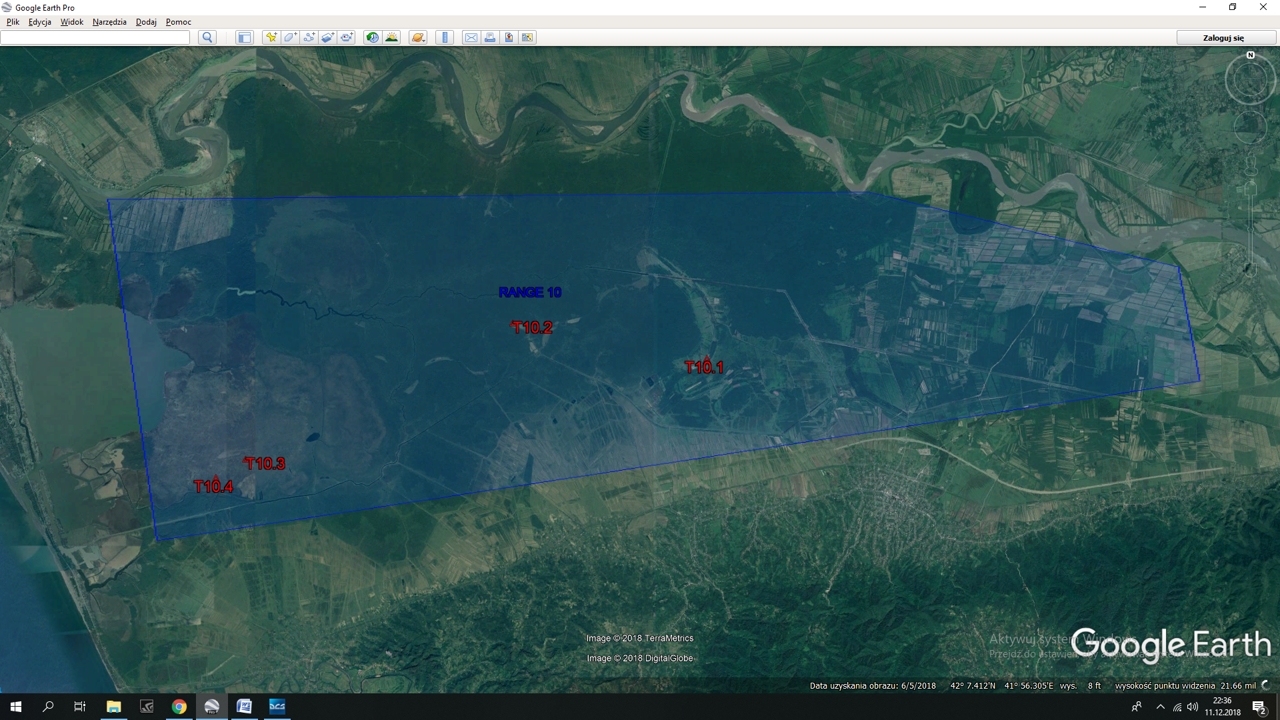
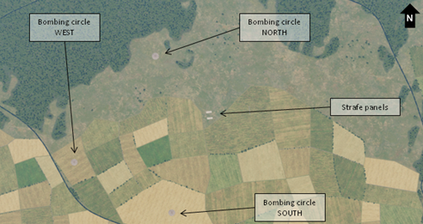
Range 10
”In Hot”
BASE
”Tipping in”
”Base”

Slide 4
BASE: 3,5 NM
40 HADB
BASE
20.0K AGL
3,5 NM
300KCAS
40˚
420 KCAS
13,0K AGL
4,0 NM
4,5 NM
10,0K AGL

Slide 5
BASE: 3,5 NM
40 HADB
BASE
20.000ft AGL
4,5 NM SLANT
300KCAS
40˚
13.500ft AGL 12.500ft AGL
4,0 NM
420 KCAS
4,5 NM
10.000ft AGL

Slide 6
30 LALD
8.5K AGL
7.5K AGL
30˚
40˚
3.1K AGL
2.5K AGL
450KCAS
40˚
4,5 NM
1.5K AGL

Slide 7
30 LALD
9500ft AGL
7500ft AGL
30˚
40˚
450KCAS
6000ft AGL
4000ft AGL
40˚
4,5 NM
1500ft AGL

Slide 8
10 LAHD
2.0K AGL
1.3K AGL
10˚
15˚
475 KCAS
800ft AGL
500ft AGL
20˚
2,5 NM
300ft AGL

Slide 9
10 LAHD
1800ft AGL
1100ft AGL
10˚
15˚
475 KCAS
800ft AGL
500ft AGL
20˚
3 NM
300ft AGL

